Slide 1
Entering Vendor Threat Mitigation (VTM) Records

Slide 2
Entering Vendor Threat Mitigation (VTM) Records
This presentation covers
Entering VTM Records only.
For instruction on use of VTM Search Functions
view
Vendor Threat Mitigation (VTM) for VTMACQ
(VTM Acquisition Professional)

Slide 3
Note to Viewers
Screenshots
have been
edited for
size & content
to preserve
detail and
integrity

Slide 4
Overview
The Section 841 List:
up-to-date listing of
vendors with active
identifications under FY15 NDAA Sec 841, “Never
Contract with the Enemy”. Both VTM Reports &
Section 841 List have
menu items in the SPRS
Navigation Menu.
The VTM module
consists of two
parts within the
SPRS Application: VTM Reports &
Section 841 List
VTM Reports provide SPRS users with a search tool for vendors to determine if they have been assigned threat
ratings and/or assessments through a Combatant
Command (CCMD)
VTM program.
VTM Reports provide
SPRS users with a tool to
search for vendors to
determine if they have
been assigned threat
ratings and/or
assessments through a
Combatant
Command (CCMD)
VTM program.

Slide 5
VTM Program Officer (PMO) Users
Add/Edit/Delete Threat Rating Records within
SPRS Vendor Threat Mitigation (VTM) Module.
Access to SPRS VTM module only (includes Section 841 List).
VTM IC Analysts
Add/Edit/Delete Threat Assessment Records within
SPRS Vendor Threat Mitigation (VTM) Module.
Access to SPRS VTM module only (includes Section 841 List).

Slide 6
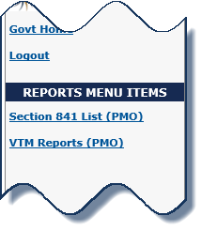
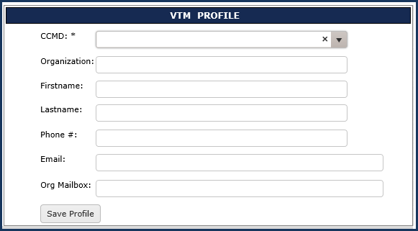
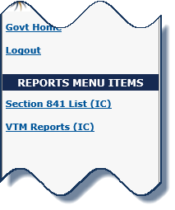
VTM User Profile
VTM Program Officer
VTM IC Analyst

Slide 7
VTM User Profile
VTM Program Officer
VTM IC Analyst

Slide 8
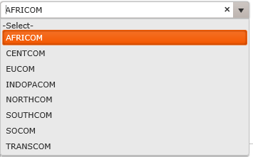
VTM User Profile
VTM Program Officer
VTM IC Analyst

Slide 9
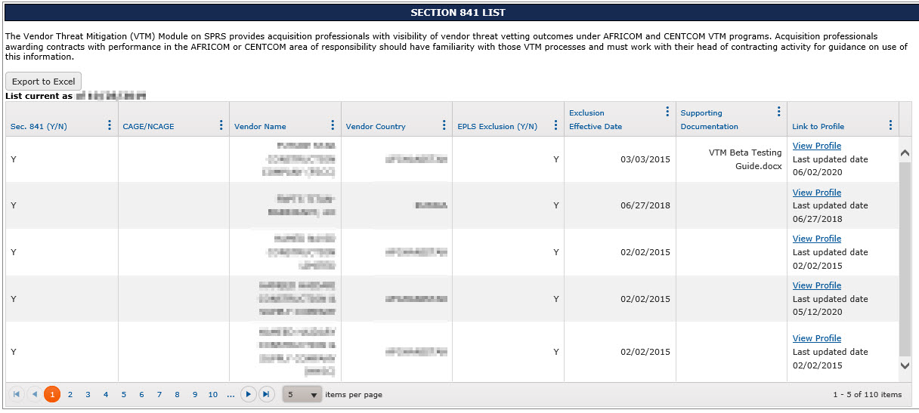
Section 841 List

Slide 10
Adding a new Record

Slide 11
Adding a new Record 2
Threat Assessment - VTM IC Analysts Only

Slide 12
Adding a new Record 4
Threat Rating - VTM Program Officers Only

Slide 13
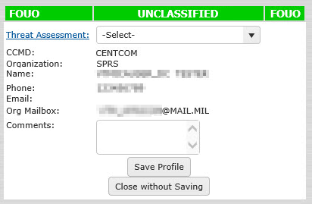
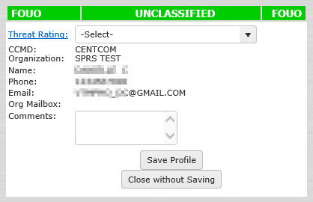
Adding a new Record 7
VTM IC Analysts Only
Threat Assessment
VTM Program Officers Only
Threat Rating

Slide 14
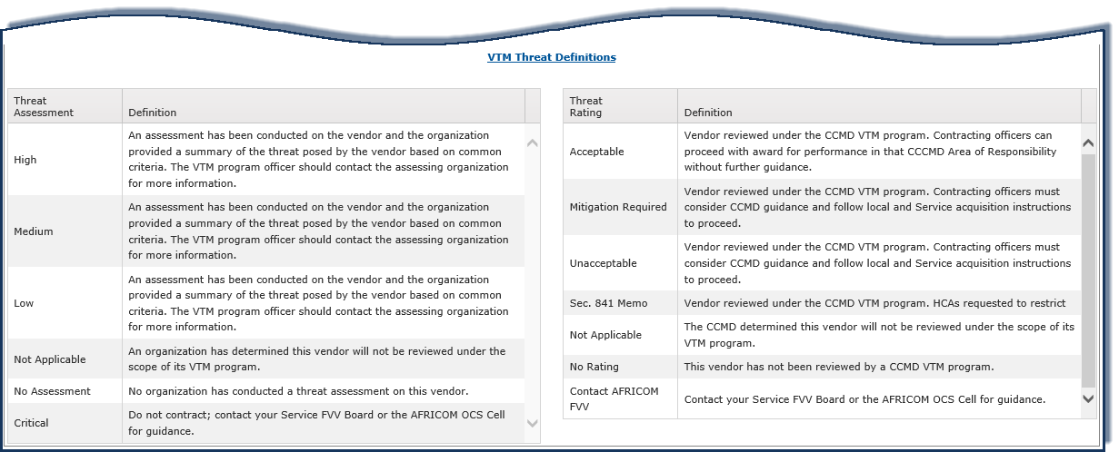
VTM Threat Definitions
VTM IC Analysts Only
Threat Assessment
VTM Program Officers Only
Threat Rating

Slide 15
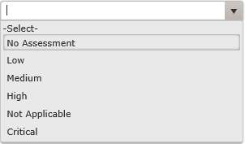
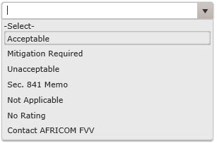
Adding a new Record 6
VTM IC Analysts Only
VTM Program Officers Only

Slide 16
Adding a new Record 5 2
VTM IC Analysts Only
Threat Assessment
VTM Program Officers Only
Threat Rating

Slide 17
Adding a new Record 5 2
VTM IC Analysts Only
Threat Assessment
VTM Program Officers Only
Threat Rating

Slide 18
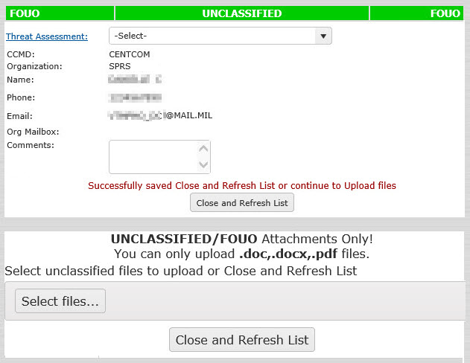
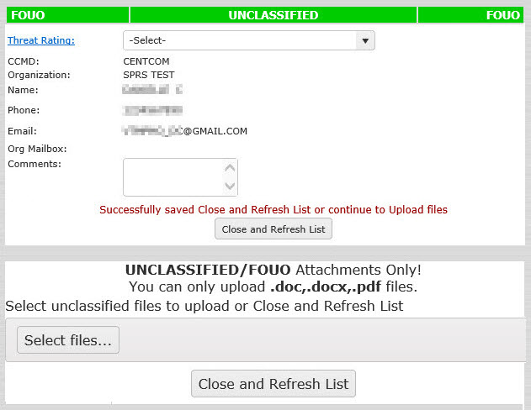
Adding a new Record 96
VTM IC Analysts Only
Threat Assessment
VTM Program Officers Only
Threat Rating

Slide 19
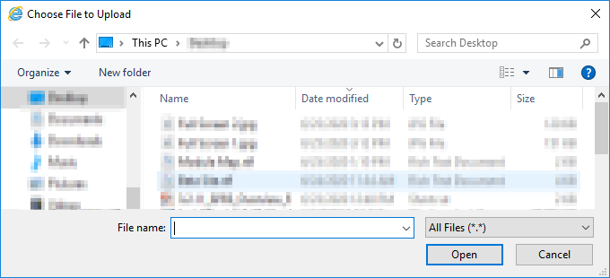
Adding a new Record 96
VTM IC Analysts Only
Threat Assessment
VTM Program Officers Only
Threat Rating

Slide 20
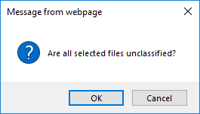
Adding a new Record 96
VTM IC Analysts Only
Threat Assessment
VTM Program Officers Only
Threat Rating

Slide 21
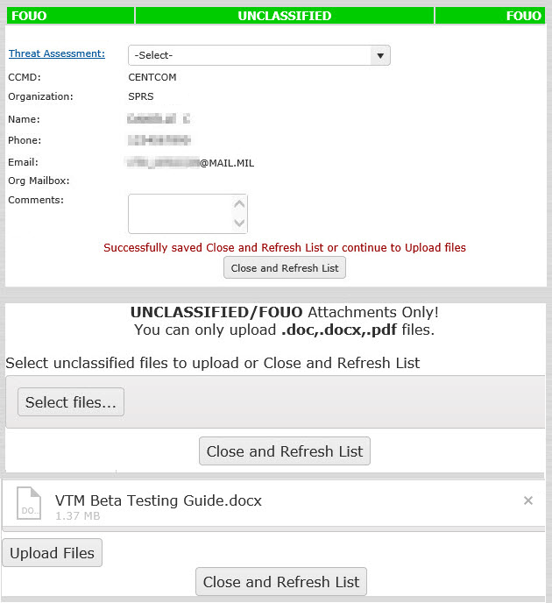
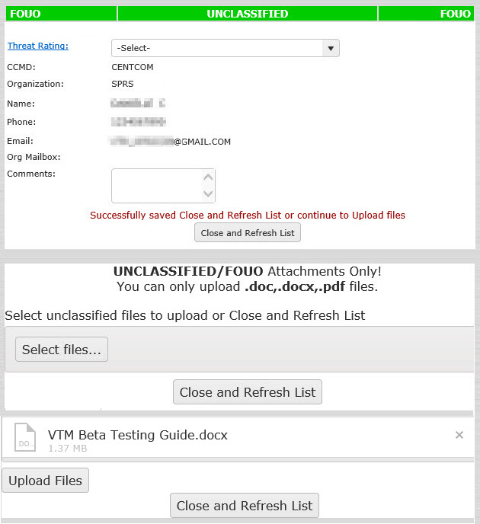
Adding a new Record 96
VTM IC Analysts Only
Threat Assessment
VTM Program Officers Only
Threat Rating

Slide 22
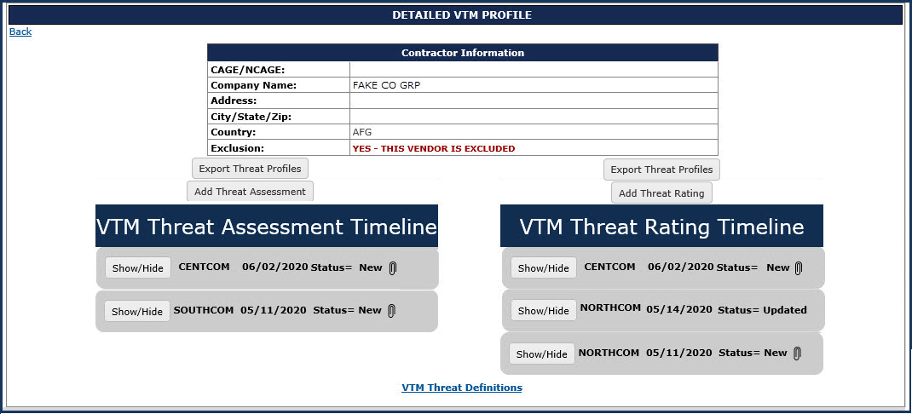
VTM Detailed Profile Overview

Slide 23
VTM Detailed Profile Overview 2
VTM IC Analysts Only
Threat Assessment
VTM Program Officers Only
Threat Rating

Slide 24
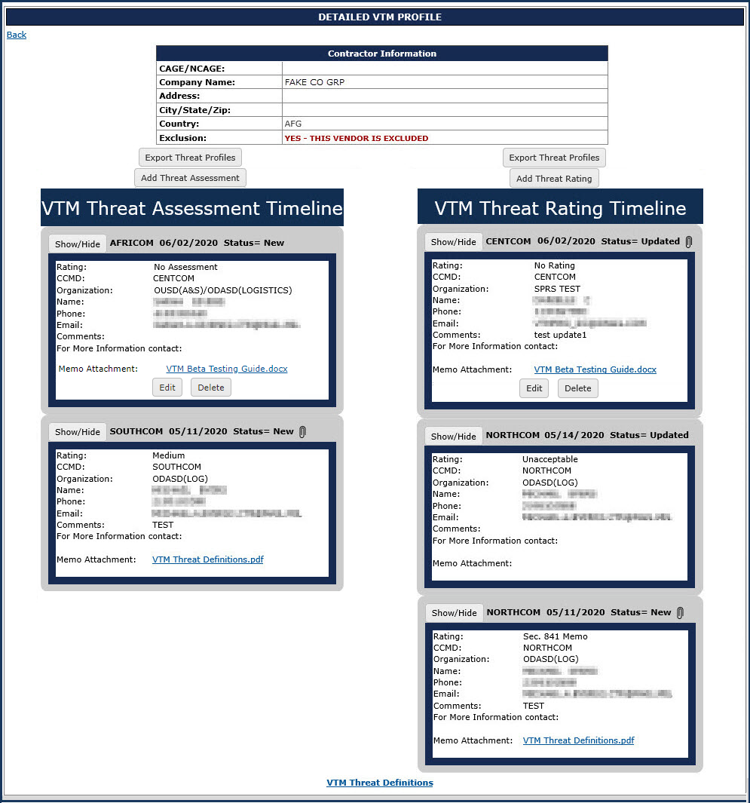
VTM Detailed Profile
VTM Program
Officers Only
Threat
Rating
VTM IC
Analysts Only
Threat
Assessment

Slide 25
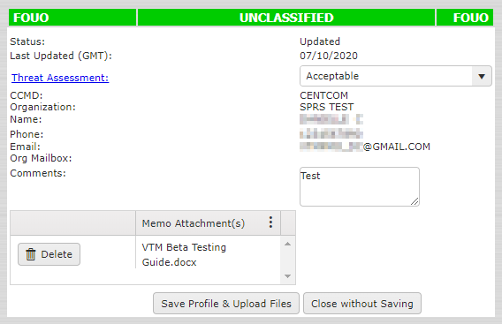
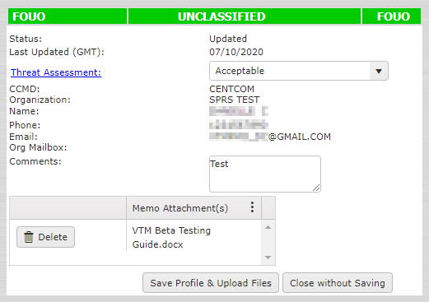
VTM Detailed Profile
Edit a Record 6
VTM IC Analysts Only
Threat Assessment
VTM Program Officers Only
Threat Rating

Slide 26
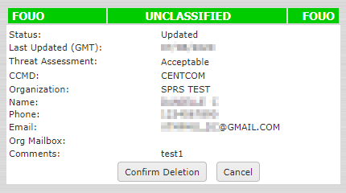
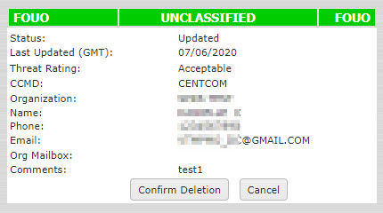
VTM Detailed Profile
Delete a Record 6
VTM IC Analysts Only
Threat Assessment
VTM Program Officers Only
Threat Rating

Slide 27
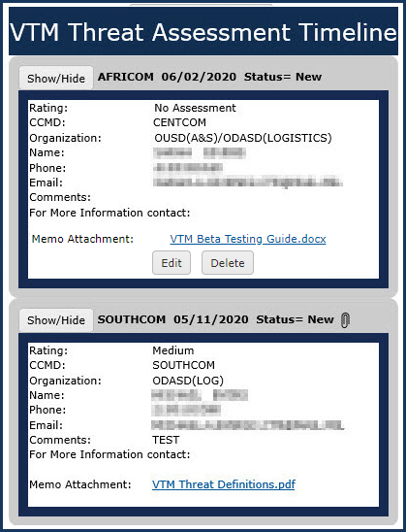
VTM IC Analysts Only Threat Assessment Timeline
Threat Assessment Level
Contact information –
Threat Rating/Assessment creator
Organization mailbox for the user
Attachments to support the vendors
Threat Rating/Assessment
(if applicable)

Slide 28
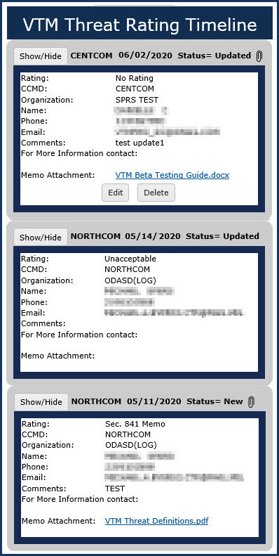
VTM Program Officers Only Threat Rating Timeline
Threat Rating Level
Characteristics are the same as those
discussed on the previous slide for
Threat Assessments
Status = New: First time a CCMD/organization posts a
Threat Rating/Assessment
Status = Updated: All subsequent postings of a
vendor’s Threat Rating/Assessment within the same
CCMD/organization.

Slide 29
SPRS Contact Information
SPRS Website:
https://www.sprs.csd.disa.mil
NSLC Help Desk (Mon-Fri 6:30am- 6:00pm ET) :
(207) 438-1690
DSN 684-1690
NSLC Help Desk Email: webptsmh@navy.mil

Slide 30
Thank You
Thank
you
for participating in
SPRS
Entering Vendor Threat Mitigation (VTM)
Records

